Slide 1
PR283 C# Theseus and Minotaur
JAMES GABIANA FINAL PRESENTATION
STUDENT ID 11981342

Slide 2
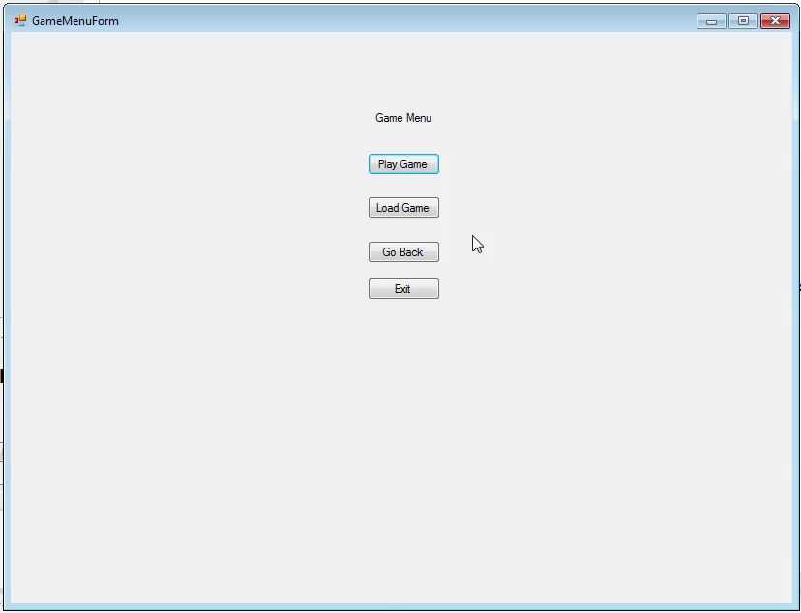
Game Play
Click to play video

Slide 3
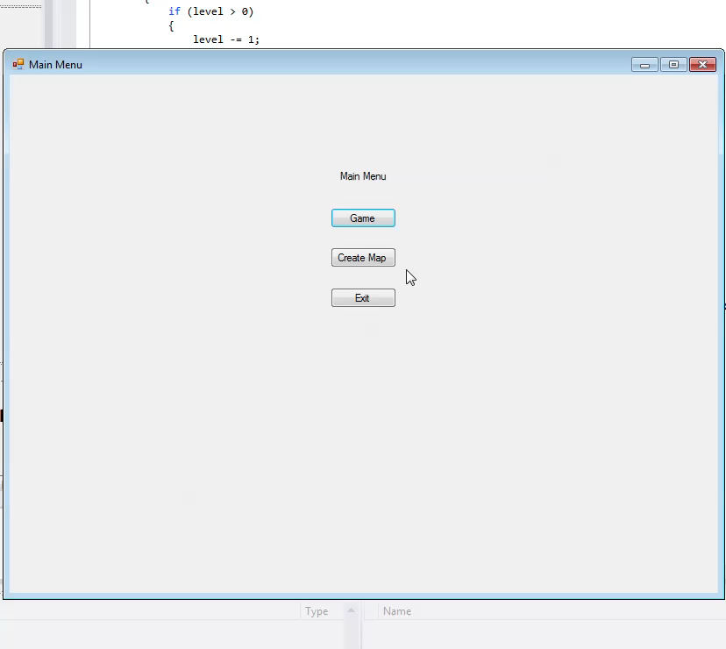
Level Designer Creating new map
Click to play video

Slide 4
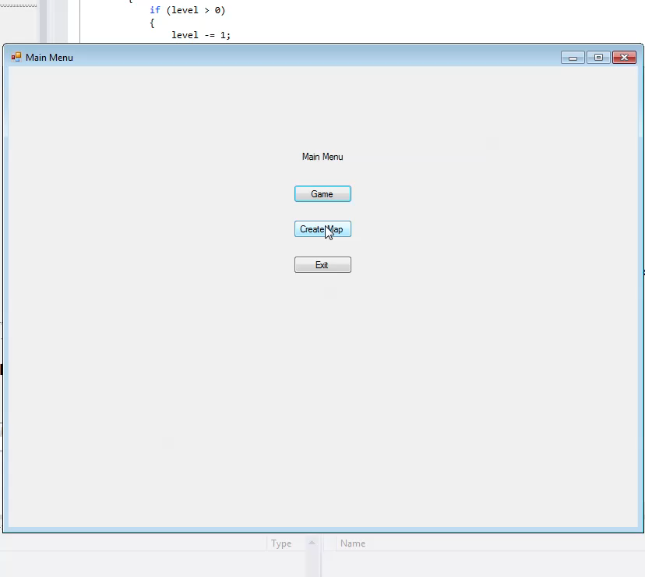
Level Designer Edit Existing map
Click to play video

Slide 5
Filer
Click to play video

Slide 6
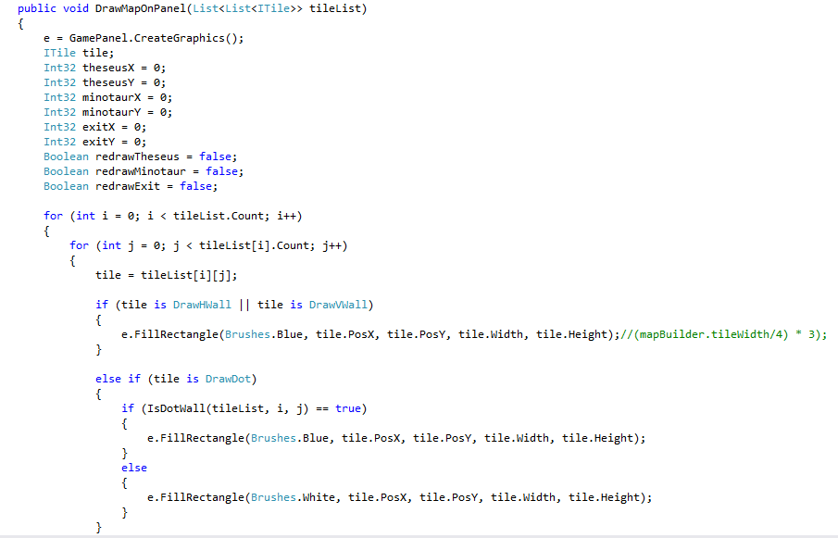
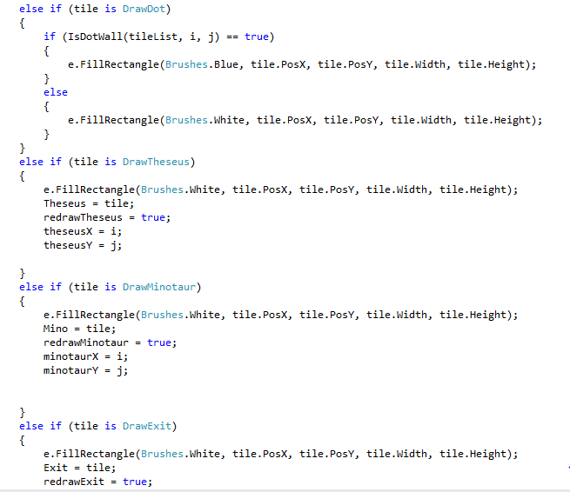
Game
Drawing Map
MUST HAVE
working Level 1 draw tile with walls/exit based on their Point draw T draw M

Slide 7
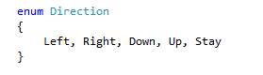
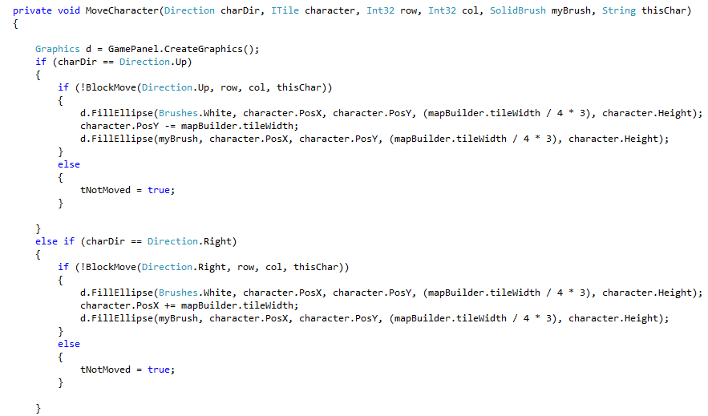
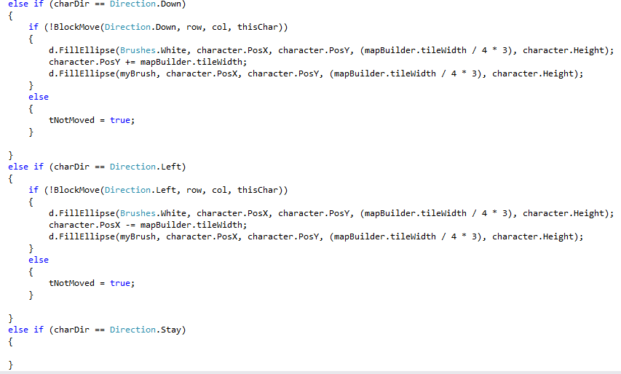
Game
Moving Theseus
MUST HAVE
View Updates after each move

Slide 8
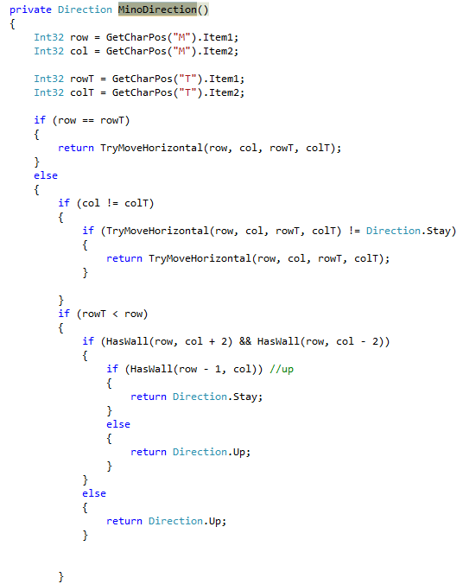
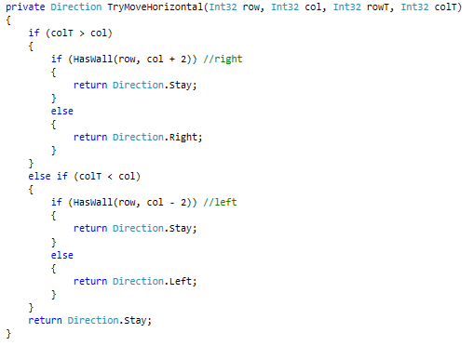
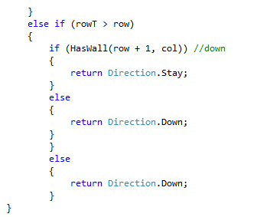
Game
Minotaur Movement
MUST HAVE
View Updates after each move

Slide 9
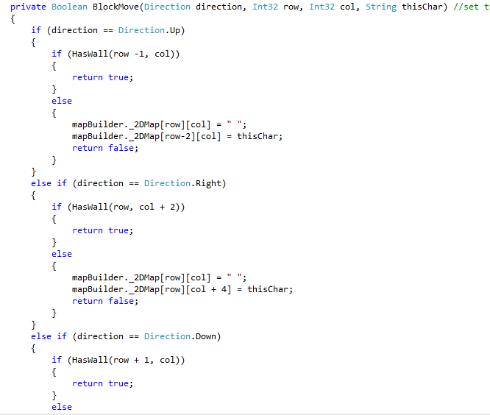
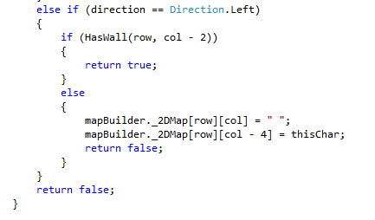
Game
Boolean Block Wall
MUST HAVE
View Updates after each move

Slide 10
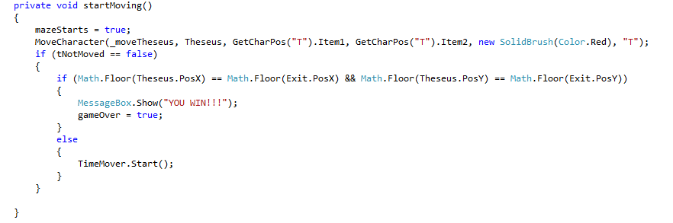
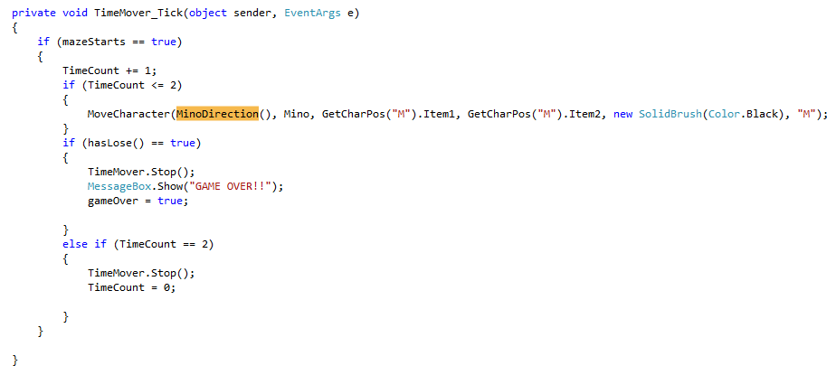
Game
Minotaur Movement Two Step Timer and Win/Lose State
MUST HAVE
end game messages (finish/die)

Slide 11
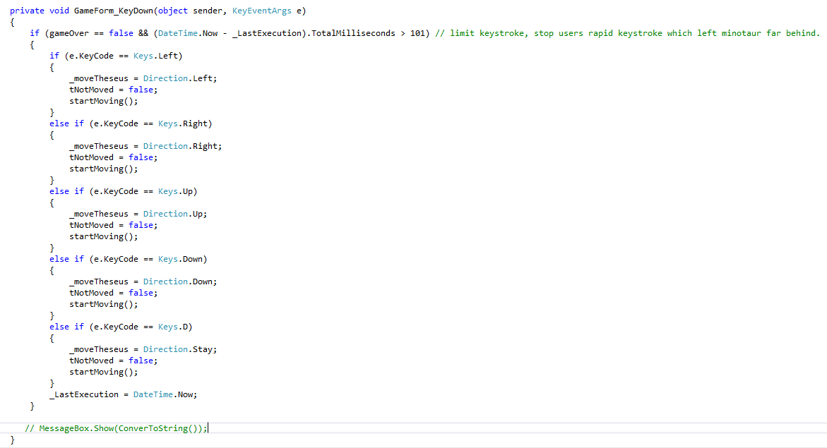
Game
Control of Game
MUST HAVE
creates controller
keyboard input from view to move Theseus

Slide 12
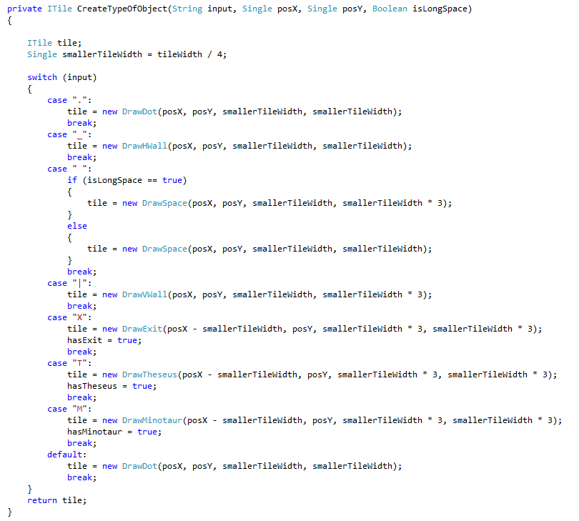
Game
Object Conversion
SHOULD HAVE convert from filer input to objects

Slide 13
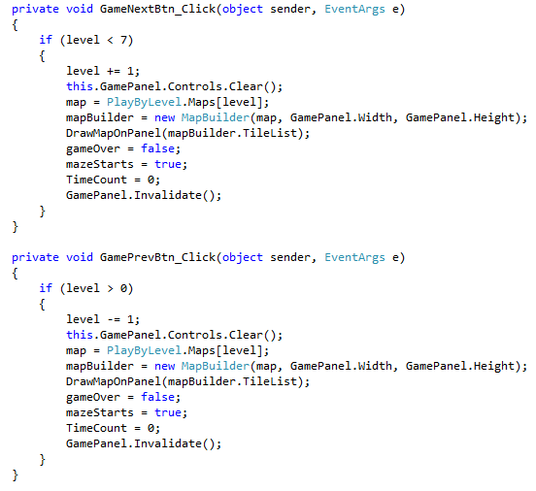
Game
Load Maps
SHOULD HAVE multiple maps inputs to change the map

Slide 14
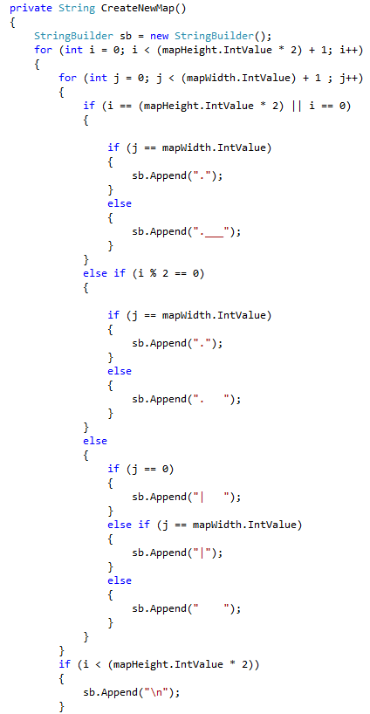
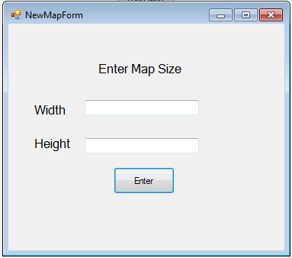
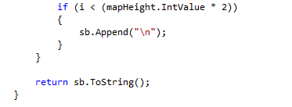
Level Design
Create new Map
MUST HAVE Must have a text control to set the width of the maze Must have a text control to set the height of the maze

Slide 15
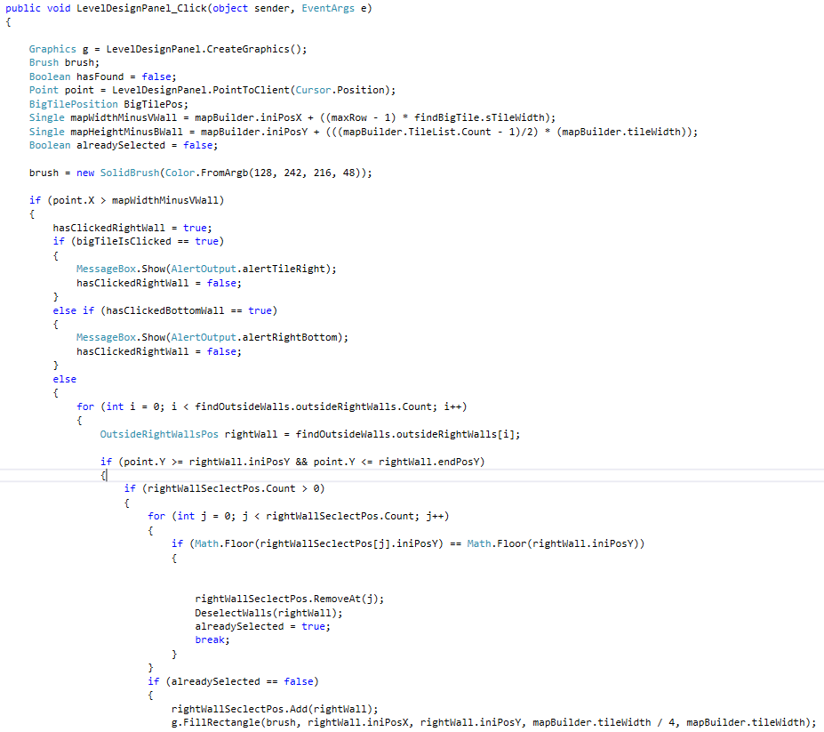
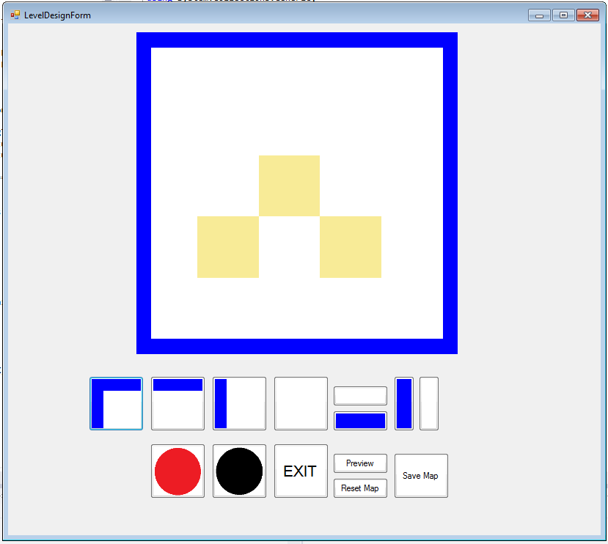
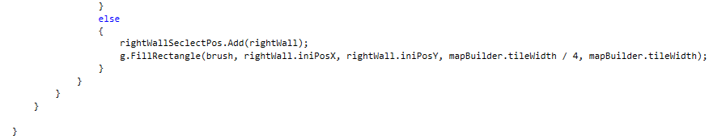
Level Design
Selecting Tile
MUST HAVE Must be able to draw and remove Theseus at the given coordinates Must be able to draw and remove Minotaur at the given coordinates Must be able to draw and remove Exit at the given coordinates Must be able to draw and remove a horizontal wall at the given coordinates Must be able to draw and remove a vertical wall at the given coordinates

Slide 16
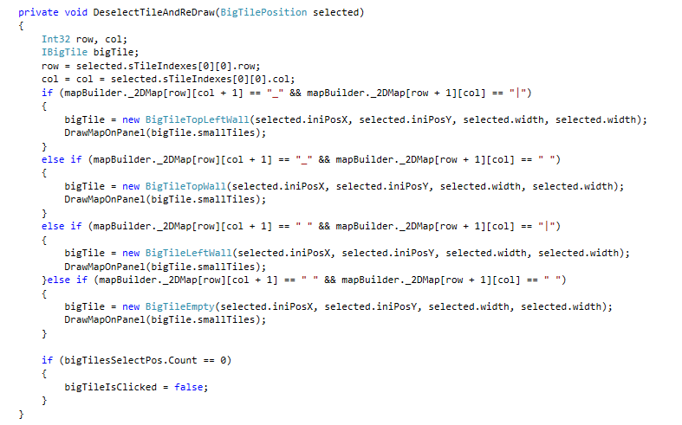
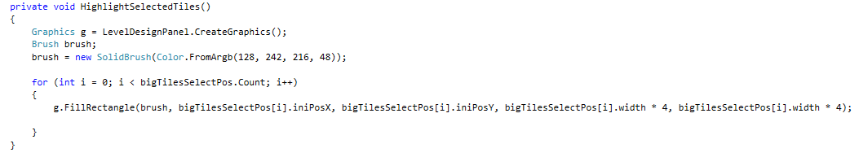
Level Design
Selecting Tile
MUST HAVE Must be able to obtain coordinate of selected tile

Slide 17
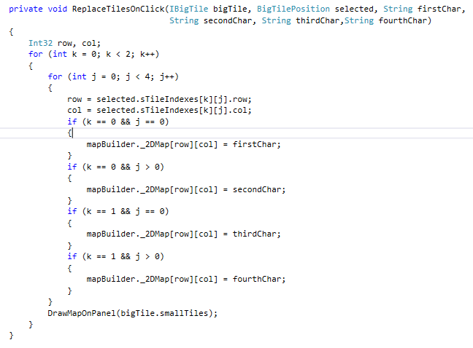
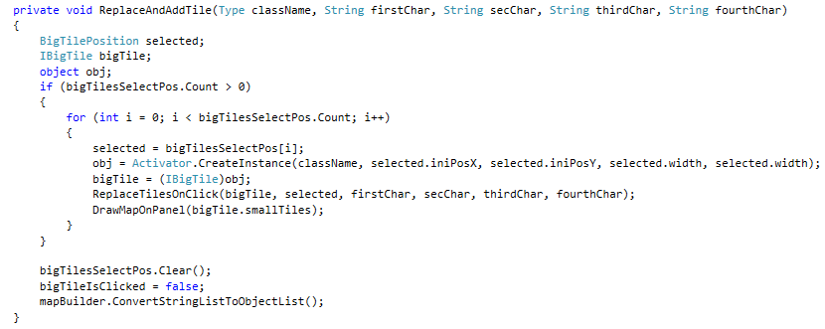
Level Design
Selecting Tile
MUST HAVE Must be able to draw and remove Theseus at the given coordinates Must be able to draw and remove Minotaur at the given coordinates Must be able to draw and remove Exit at the given coordinates Must be able to draw and remove a horizontal wall at the given coordinates Must be able to draw and remove a vertical wall at the given coordinates

Slide 18
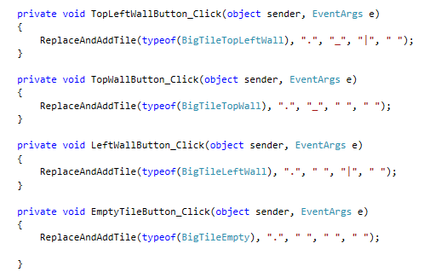
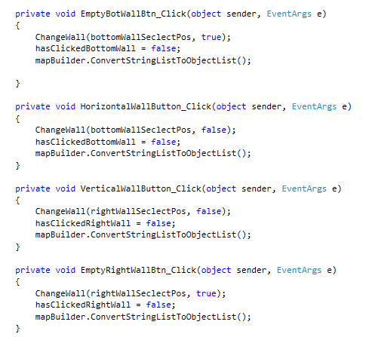
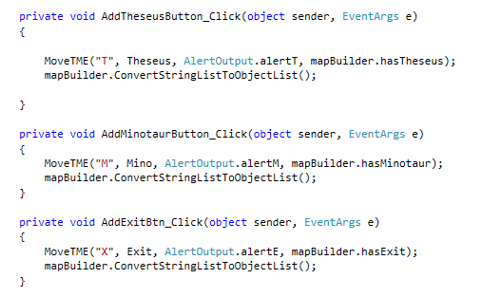
Level Design
Controls
MUST HAVE Must have control to add Theseus Must have control to add Minotaur Must have control to add Exit
Must have control to add wall

Slide 19
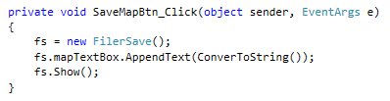
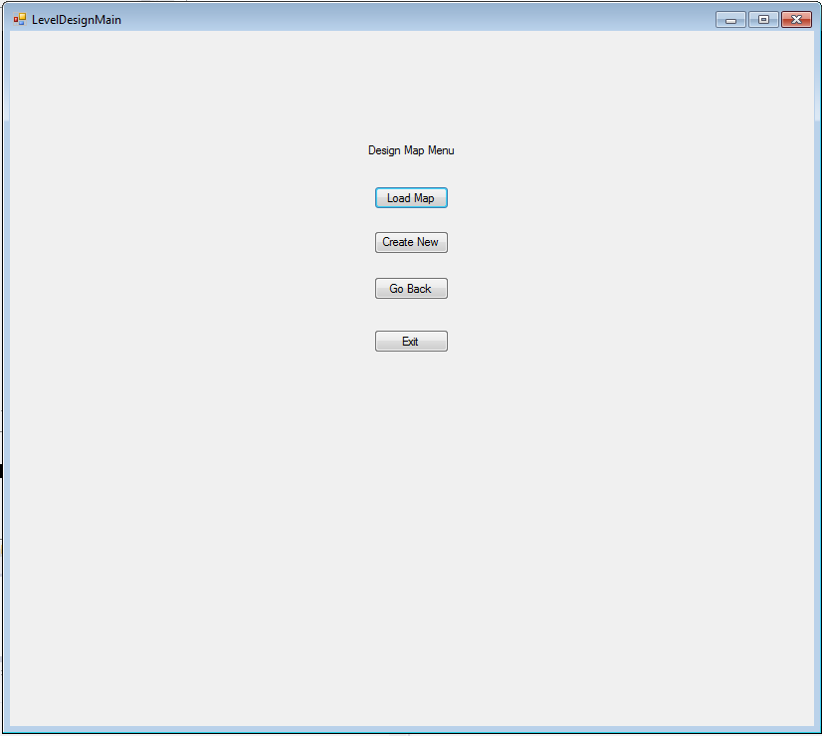
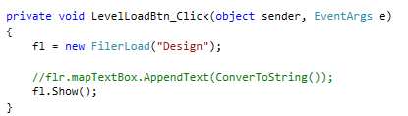
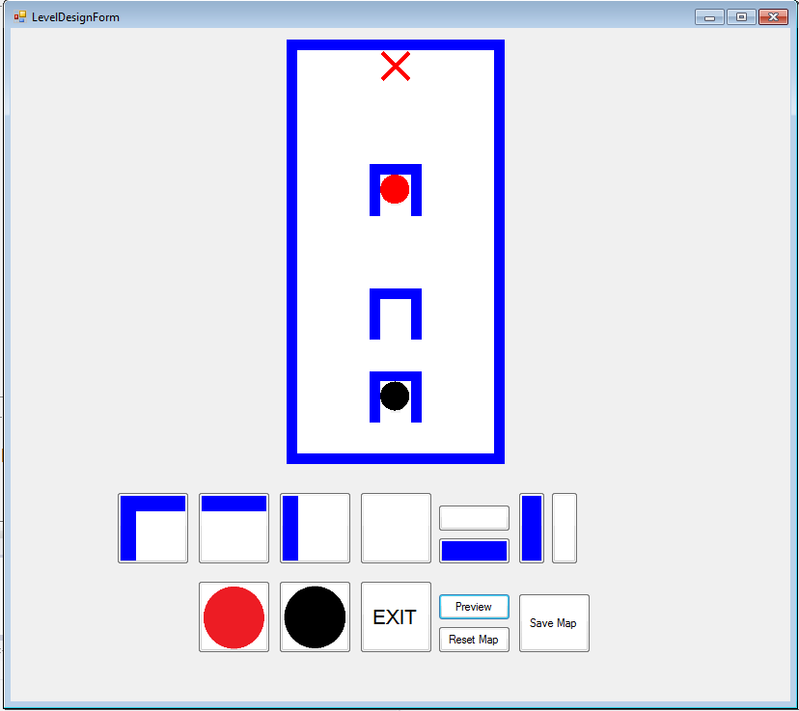
Level Design
Controls
MUST HAVE Must have a control to load a maze Must have a control to save a maze

Slide 20
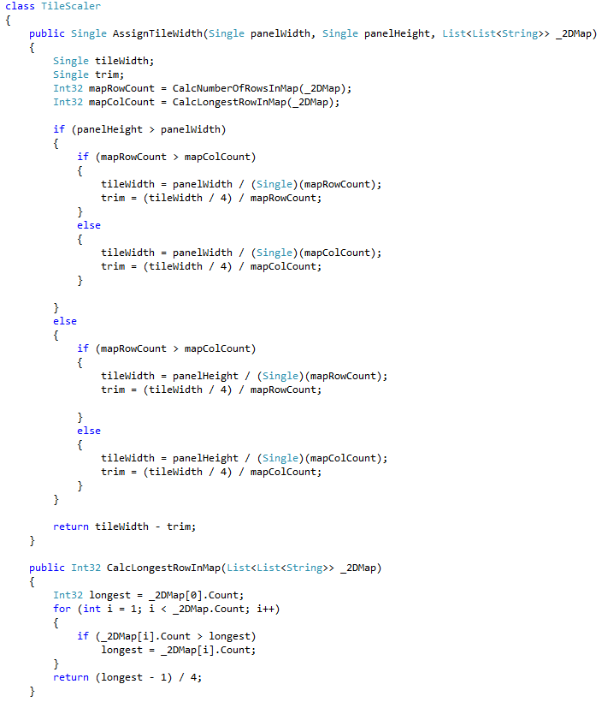
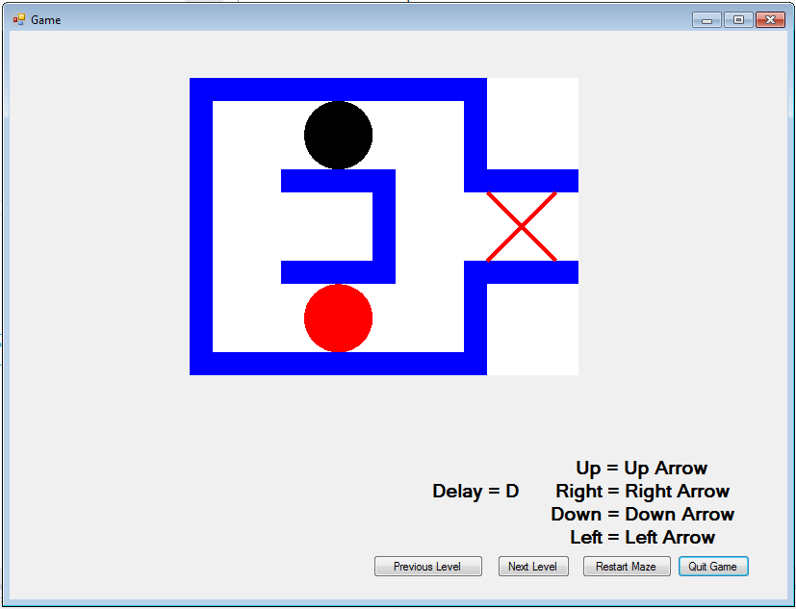
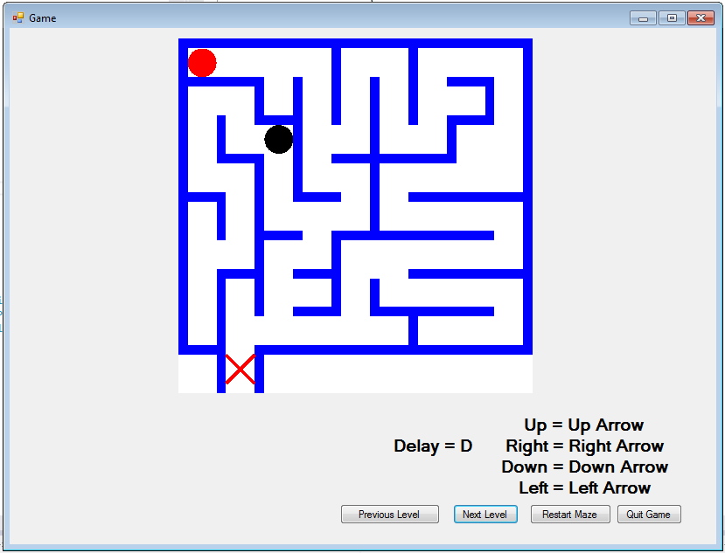
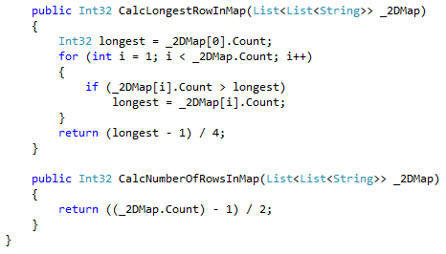
Level Design
Scale map and fit it perfectly on screen
SHOULD HAVE
Should be able to draw a grid centred on the screen Should be able to clear the grid Should be able to draw a maze given a string (loading) Should be able to export a maze (saving)

Slide 21
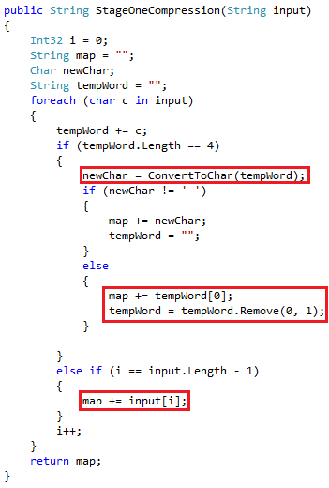
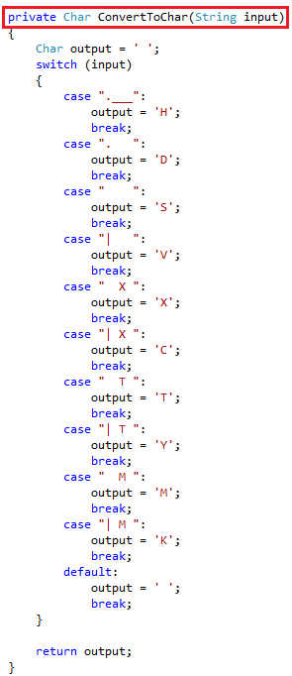
Filer
Stage 1Compression
MUST HAVE Compression
Notes:
This the stage one compression. This is where 4 characters are converted to one characters, for example “.___” will be converted to char ‘H’.
First the method will take a String input and then loop through all characters on the string input and try to match a substring called tempword with 4 characters at a time.
Match the tempWord with its equivalent one character using the method ConvertToChar().
If tempWord has a match then add that character to the return output called map, and then empty the tempWord and get the next 4 characters on the String input.
Else if it does tempWord not match, then add the first character of the tempWord to the map and then add a new character to the tempWord which is the next character on the foreach loop.
Else if the loop is at the end and no match, then add the last character to the map.

Slide 22
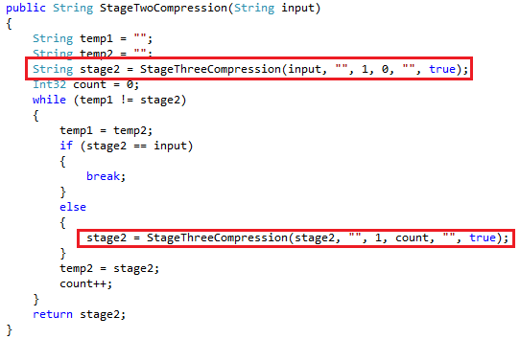
Filer
Stage 2 Compression
MUST HAVE Compression
Notes:
This is the Stage 2 Compression which focusses only one character which repeats continuously. For Example “| | | ” which is VVV becomes 3V. It does not encapsulate the V in brackets ‘[]’ because it is more conservative.
For example, the string “2[V]” would be longer than “VV”, so 2V is more conservative for repeating single characters.
The method will take a String input, and then it will do a trial which will then be stored on String stage2 variable, and then the loop will execute, if no change then the loop will break because the map cannot be compress any further.
Else Keep trying to Compress until all repeating single characters has been compressed.

Slide 23
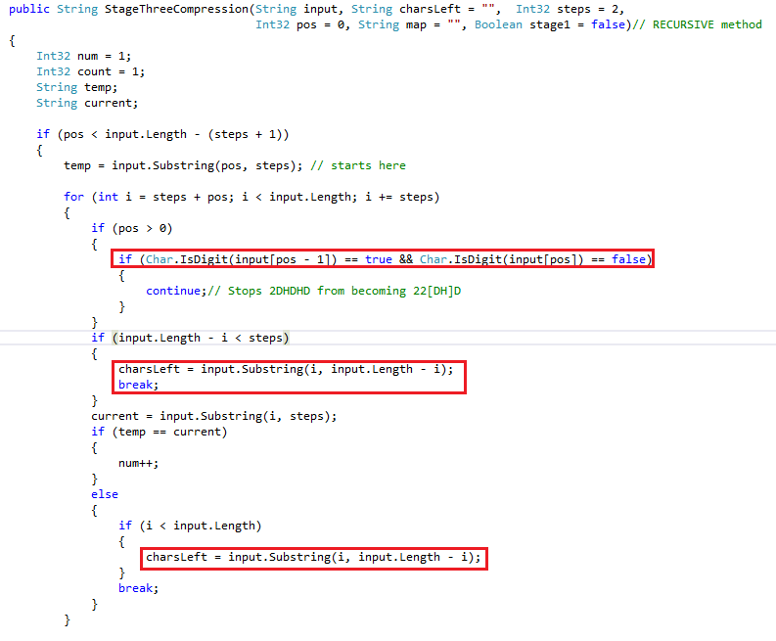
Filer
Stage 3 Compression
MUST HAVE Compression
Notes:
This is the Stage 3 Compression. This method is recursive, this is the hardest part of the Filer program.
First, the method will take an multiple arguments, String input, String charsLeft, int steps, int pos, String map, Boolean stage1.
String pos is where the first character of the new word to be match with other characters.
For example, HSVSV, pos = 0 which is H and then Steps which is 1 is V, so the match we are currently looking for is “HS”, the loop will then try and see if it matches the next two characters which is “VS”, which will return false and move to the next characters, but in this case there is only one character left which is “V” so the loop will then break. The method will then invoke itself (Recursion), and add += 1 to pos but not to step.
This time, pos = 1 and step is still one so the new current word to be match with other word will now be “SV”, and the next two characters is also SV so value of num will now increase by 1.

Slide 24
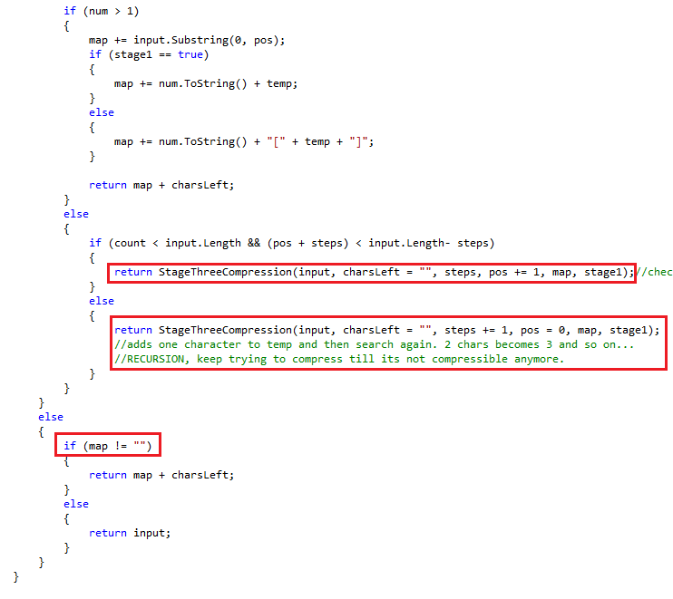
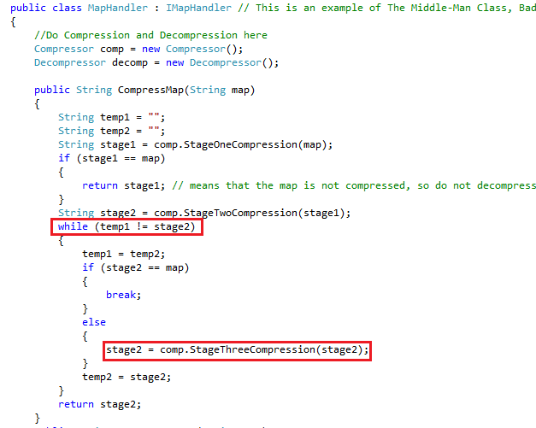
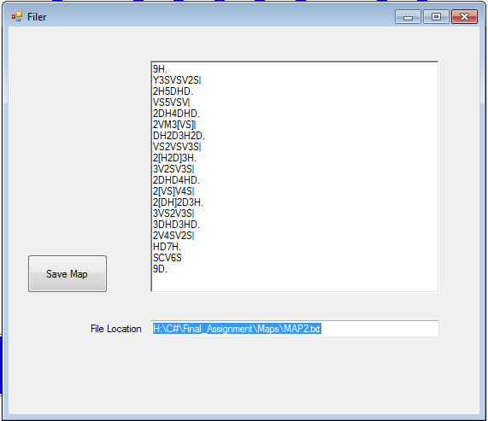
Filer
Stage 3 Compression
MUST HAVE Compression
Notes:
It will now go and add that value of variable “num” to map followed by the two chracters “SV”, and it will also add the characters before that which on this case is char “H” and if there are uncompressed characters it will also add them to the return map.
MapHandler class is an example of the Middle class which is a bad smell. It uses methods from Compressor and Decompressor classes to do a task. It acts just like a Controller class.
I could have rewrite my code so that one method do all the Compressions but the method would become very complex and very long. So I broken them down to different stages and created the class MapHandler to make it little bit more readable.
The method Compressmap() in MapHandler will keep running StageThreeCompression() method compress the map as much as possible.

Slide 25
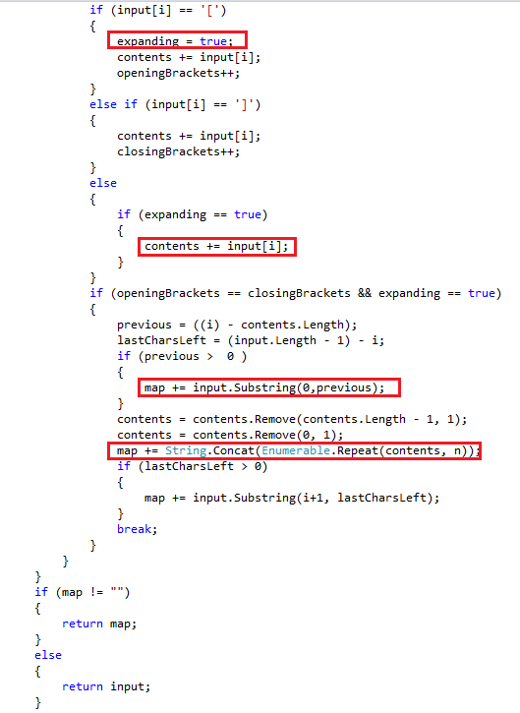
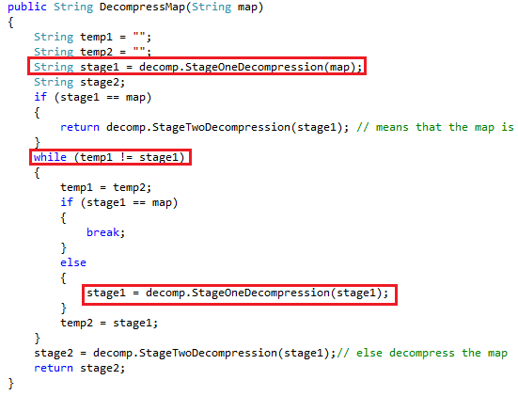
Filer
Stage 1 Decompression
MUST HAVE Decompression
Notes:
This is the Stage1 Decompression. The responsibility of this method is to Expand all the characters and to fully prepare it for the Stage2 Decompression which is to convert each characters to its equivalent String.
First the method takes a String input. The method will then loop through all the characters of the input and look for numbers and brackets.
It then needs to know if the current character is a number or not. If it is a number then it will then needs to know what the next character is, if the next character is not a number and not an opening bracket, that means it’s a number followed by a character which is repeating, For example ‘3V’ will be expanded as “VVV”.

Slide 26
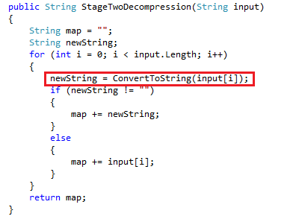
Filer
Stage 2 Decompression
MUST HAVE Decompression
Notes:
The responsibility of this method is to convert all single characters to its equivalent String.
It will loop through all the characters of the String input and then add the equivalent string to the String map.
And then return the String map.

Slide 27
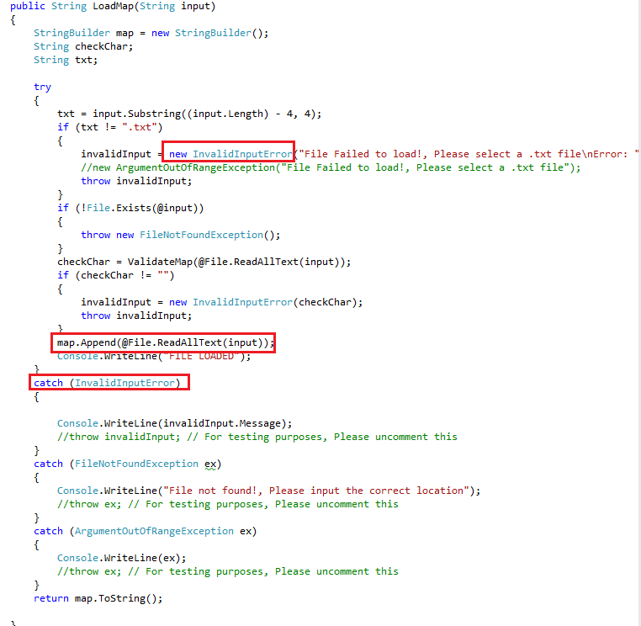


Filer
Load/Save/Exception
MUST HAVE Exception handling
Read a text file Save a text file
View all level-subjects that have been loaded (Harrison)

Slide 28
Summary of marks expected(GAME)
What I Implemented
Must Have: 10/10
working Level 1
draw tile with walls/exit based on their Point
draw T
draw M
creates controller
MVC
reads from model
keyboard input from view to move Theseus
end game messages (finish/die)
View updates after each move
Should Have: 3/3
multiple maps
inputs to change the map
convert from filer input to objects
Could Have:
MUST
I think I should get perfect mark for the must have features for the game because I implemented all of them and they all works.
SHOULD
I think I should get perfect mark for the should have features for the game because I implemented all of them and they all works.

Slide 29
Summary of marks expected(Level Designer)
What I Implemented
Must Have: 15/15
1. Must be able to draw a grid 2. Must have a text control to set the width of the maze 3. Must have a text control to set the height of the maze 4. Must be able to obtain coordinate of selected tile 5. Must be able to draw and remove Theseus at the given coordinates 6. Must be able to draw and remove Minotaur at the given coordinates 7. Must be able to draw and remove Exit at the given coordinates 8. Must be able to draw and remove a horizontal wall at the given coordinates 9. Must be able to draw and remove a vertical wall at the given coordinates 10. Must have control to add Theseus 11. Must have control to add Minotaur 12. Must have control to add Exit
13. Must have control to add wall 14. Must have a control to load a maze 15. Must have a control to save a maze
Should Have: 4/4
1. Should be able to draw a grid centred on the screen 2. Should be able to clear the grid 3. Should be able to draw a maze given a string (loading) 4. Should be able to export a maze (saving)
Could Have:
MUST
I think I should get perfect mark for the must have features for the level Designer because I implemented all of them and they all works.
SHOULD
I think I should get perfect mark for the should have features for the Level Designer because I implemented all of them and they all works.

Slide 30
Summary of marks expected(Filer)
What I Implemented
Must Have: 15/15
Read a text file
Save a text file
View all level-subjects that have been loaded (Harrison)
Compression
Expansion
Exception handling
My Own Should Have: 2/2
Multiple levels of Compression(stage1, stage 2, stage 3)
Multiple levels of Decompression(stage1, stage 2)
Could Have:
MUST
I think I should get perfect mark for the must have features for the Filer because I implemented all of them and they all works.
SHOULD
I think I should get perfect mark for the should have features for the Filer because I implemented all of them and they all works.

